Slide 1
Update by the ‘VQA’ Team
MI Meeting – 08/15/2018
Vincent MAROIS
Younes BOUHADJAR – Vincent ALBOUY – Jayram THATHACHAR

Slide 2
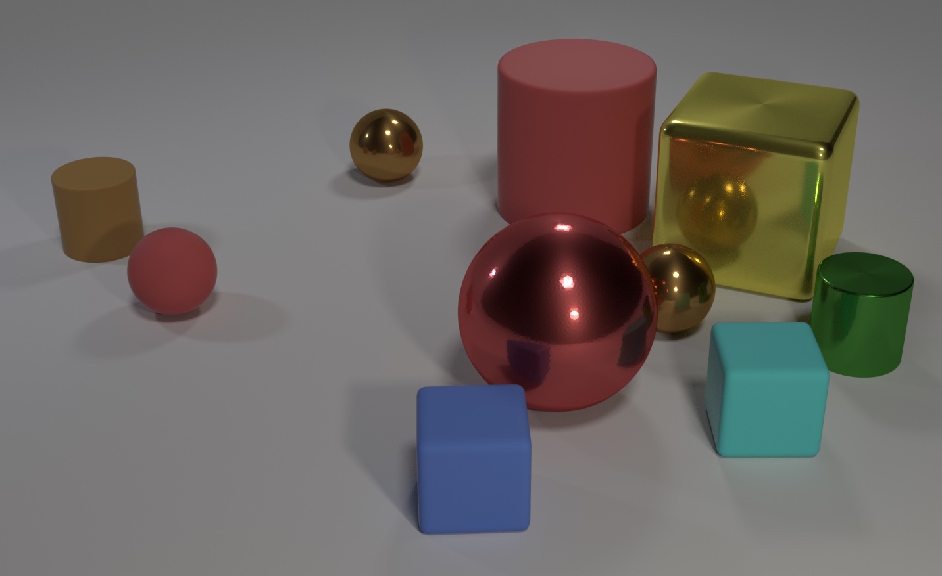
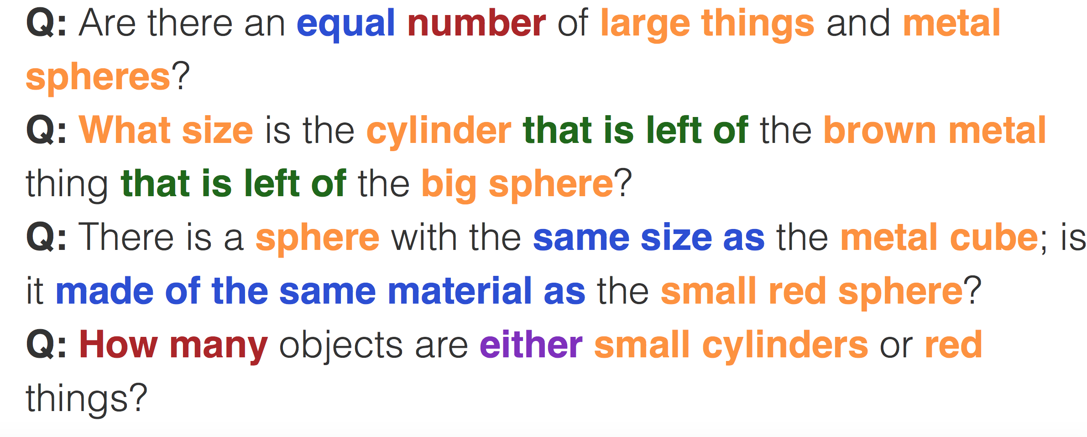
CLEVR Dataset: State of the Art
Model | Validation Accuracy
FiLM (Sept 17) | 97.7%
MAC (March 18) | 98.9% (-> 99.5%)
Transparency by Design (July 18) | 99.1%
Our MAC implementation | 100% can be reached, 97% on average
Notes:
Do a quick recap on VQA and more specifically the CLEVR dataset. Indicate that CLEVR is mostly solved (99%+ accuracy by several models).
Can indicate that accuracy depends on implementation.

Slide 3
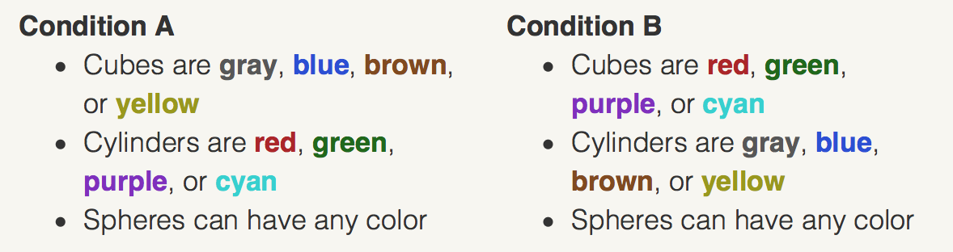
CLEVR CoGenT: Compositional Generalization test
CLEVR Dataset
CLEVR Humans
Same pictures as CLEVR
Questions written by humans:
What shape is the object reflected in the blue cylinder?
What number of cylinders share the same color?
How many objects are not purple and not metallic?
What color is the object partially blocked by the purple cylinder?
-> Train on A
-> Validate on A & B
-> Fine-tune on B
-> Validate on A & B again
Notes:
Present the variant of CLEVR: CLEVR-Humans & CLEVR-CoGenT:
CLEVR-Humans: Generalization test, based on less constrained questions (written by humans)
CLEVR-CoGenT: Compositional Generalization test, more limited than CLEVR-Humas only focus on distinction between shapes & colors
Select CLEVR-CoGenT as problem is more specified (‘How to improve distinction / understanding of shapes vs colors ?’)
Explain meaning of validation before/after finetuning on CoGenT

Slide 4
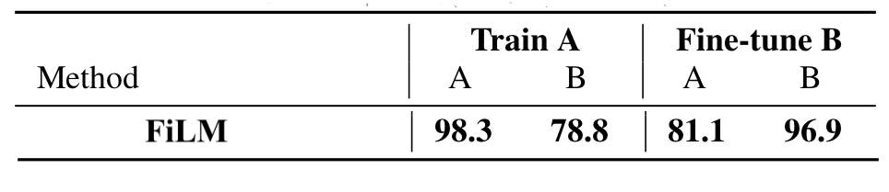
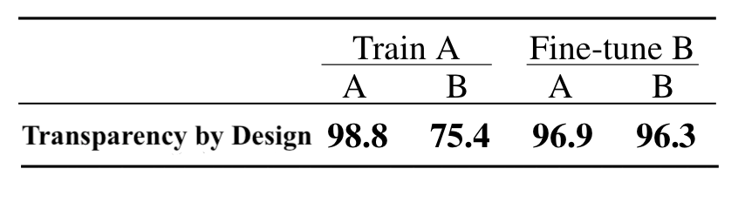
CLEVR CoGenT: Current state of the art
Method
MAC Network not evaluated on CLEVR-CoGenT
Room for improvement on Train A -> Validate B
Notes:
Present the current state of the art on CoGenT: Achieved by TbD (July 2018), relatively big improvement from FiLM (September 2017) on fine-tuning B & Val A: Do not forget the samples we have seen in TrainA when finetuning with new samples.
But: Lower accuracy on Train A -> Validate B.

Slide 5
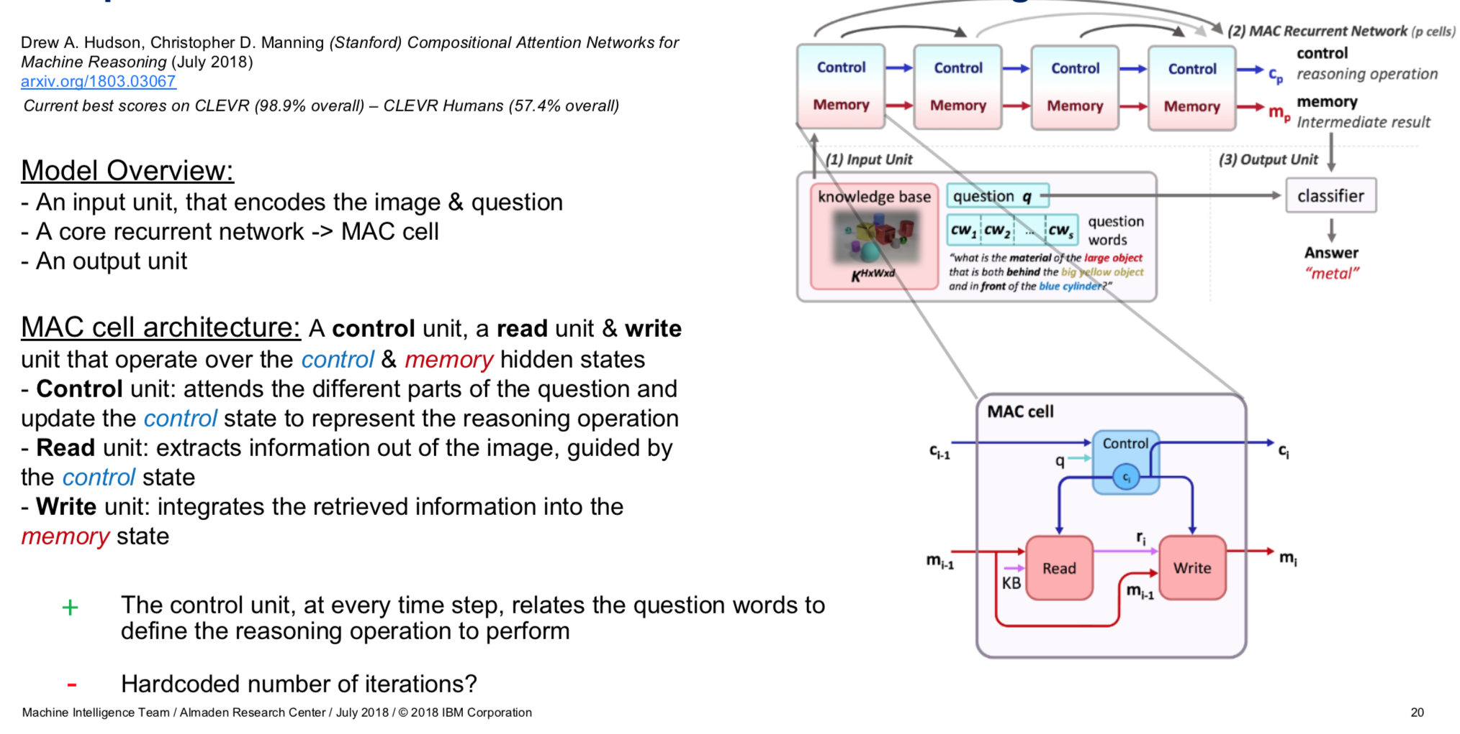
Memory – Composition – Attention (MAC)
Drew A. Hudson, Christopher D. Manning (Stanford), Compositional Attention Networks For Machine Reasoning (July 18). Published as a conference paper at ICLR 2018.
https://arxiv.org/abs/1803.03067
Notes:
Present the MAC (Memory Attention Composition) model:
- Input Unit -> Recurrent MAC Cell -> Output Unit
- Architecture of the MAC Cell
- Use of Control & Memory states
- Etc

Slide 6
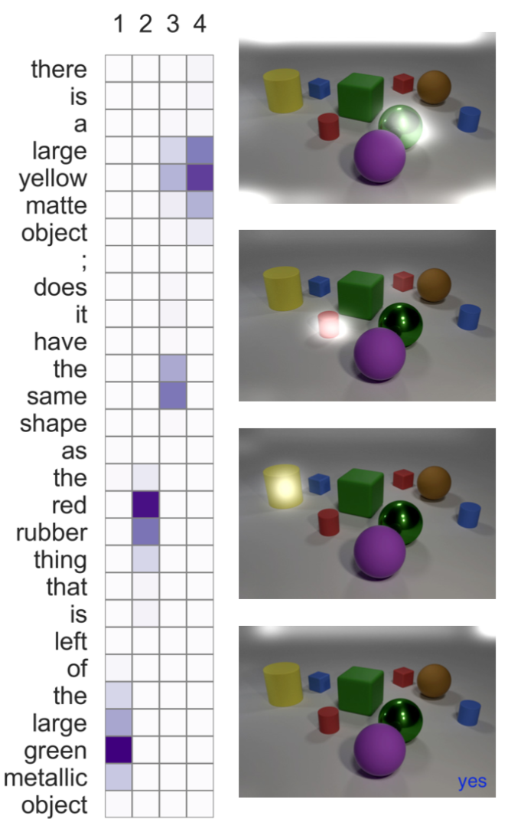
Memory – Composition – Attention (MAC)
1
Attractivity:
Simplicity – ‘Uniformity’
End-To-End differentiable
Not specifically designed for VQA ?
Interpretability: Attention map over the question words & the image
Prometheus-friendly 🙂
2
3
4
Notes:
Explain the attractive points of MAC:
Uniformity of the model: Reasoning steps are identical in terms of equations
Does not use the ground truth programs to be trained: only need (image, question, answer)
Not specifically designed for VQA ? Could be applied to QA ?

Slide 7
Memory – Composition – Attention (MAC)
Downsides:
Exact equations are rather hard to interpret: Why this choice of operations & this order ? Why using combinations of linear layers instead of a single linear layer ?
MAC cell : Not designed to make a clear distinction between shape vs color or object vs relation, treat them equally (yet succeeds to make reasoning hops)
But…
Notes:
Talk about the downsides / weaknesses of MAC:
- Digging into the equations allow us to have a very clear understanding of the structure
No mechanism forcing MAC to do a specific distinction for shape or color

Slide 8
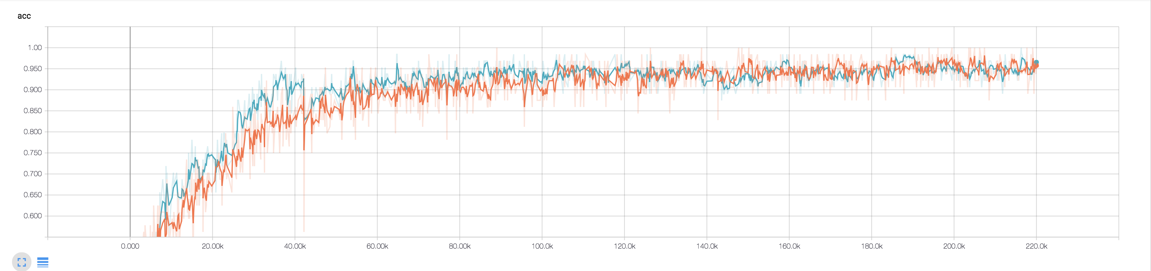
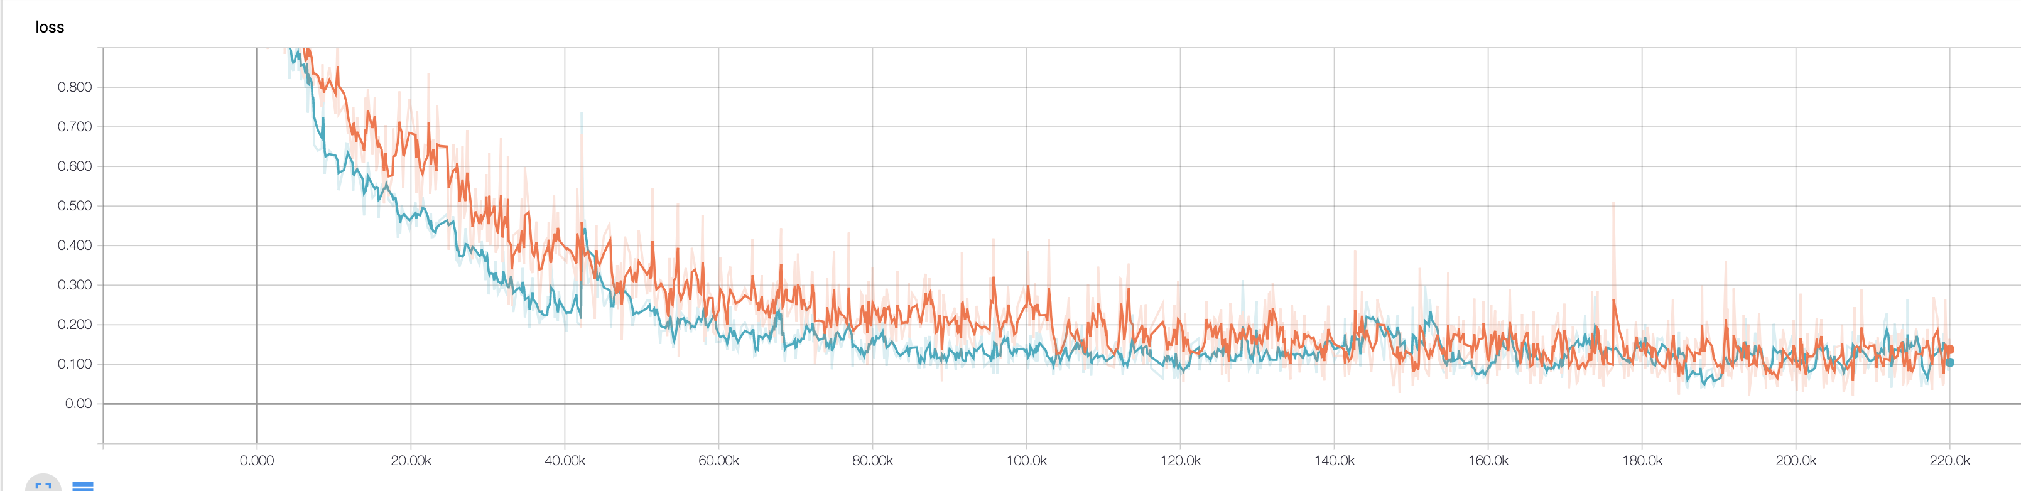
A simpler variant of MAC
Validation Accuracy
Simplified model
Last 10K iterations:
MIN: 89%
MAX: 100%
MEAN: 94.9%
STDDEV: 1.9%
Validation Loss
Best observed model
Last 10K iterations:
MIN: 94%
MAX: 100%
MEAN: 97%
STDDEV: 1.6%
Notes:
Present the results we have gathered in the last couple of weeks:
Analysis of the flow of equations and how to simplify them: Can keep similar performance and reduce wall time. Also gives room for lot of extensions. Other models are complex and hard to see where to improve

Slide 9
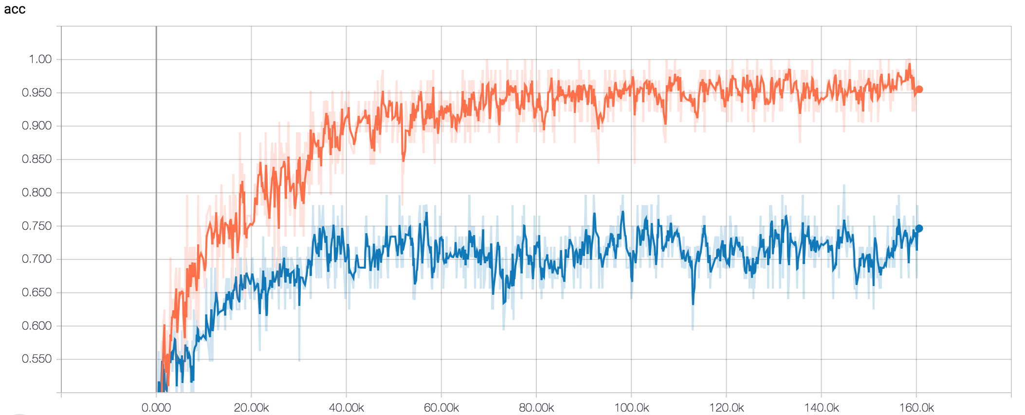
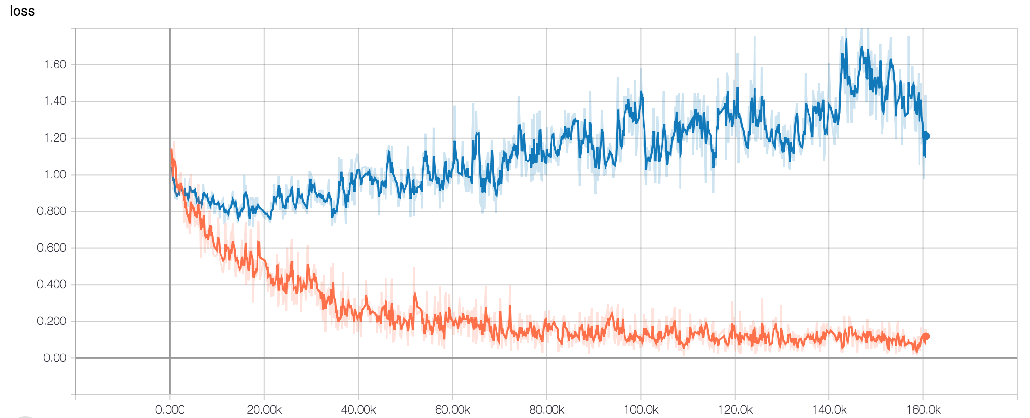
Evaluation of MAC on CoGenT
Validation Accuracy
Last 10K iterations:
MIN: 66%
MAX: 81%
MEAN: 72%
STDDEV: 3.5%
Validation Loss
Notes:
Present the results we have gathered in the last couple of weeks:
Visualization of the attention maps during the reasoning hops
Evaluation of MAC on CoGenT: Which question types are causing it to fail

Slide 10
Follow-up Questions
Diagnose failures of MAC on CoGenT: Difficulty to predict shape ? Color ?
How to ’force’ MAC to better distinct shape & color ? Change in Control Unit ? Read Unit ?
Notes:
These are the questions & tasks that we would like to tackle now:

Slide 11
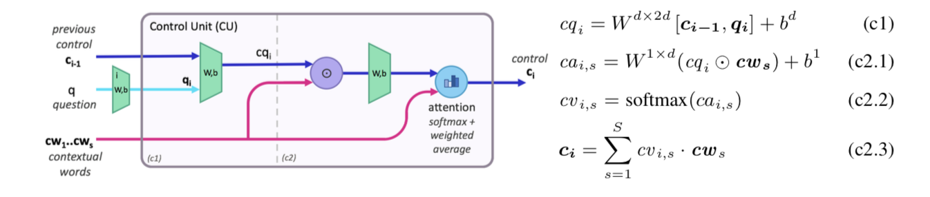
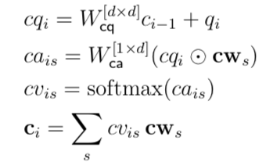
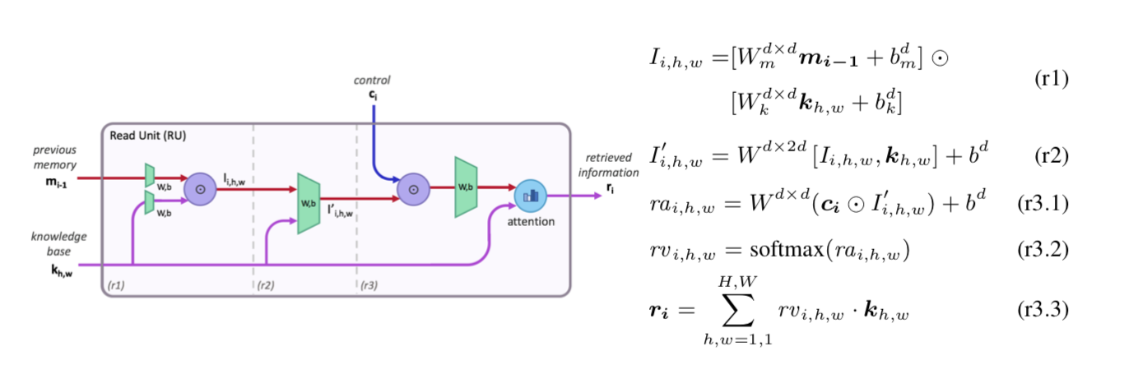
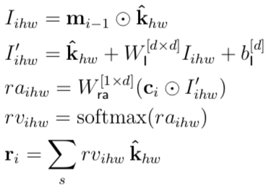
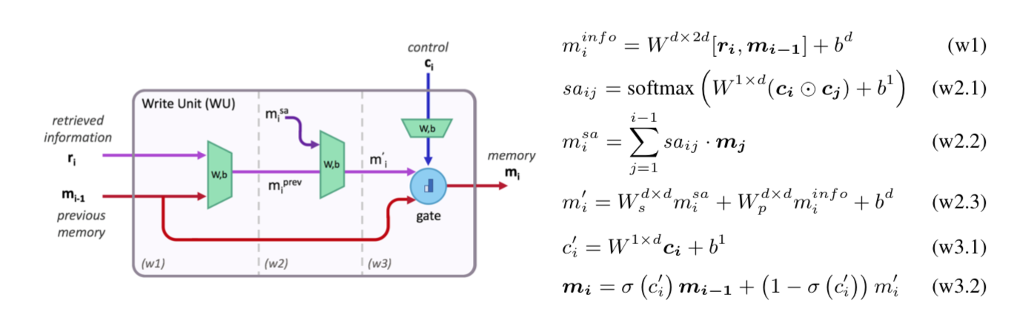
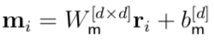
Appendix: Detail of the MAC Cell
Control Unit
SIMPLIFIED
ORIGINAL
Read Unit
Write Unit
Notes:
I’ve put an appendix with more technical detail as a support for discussion if needed.

Slide 12
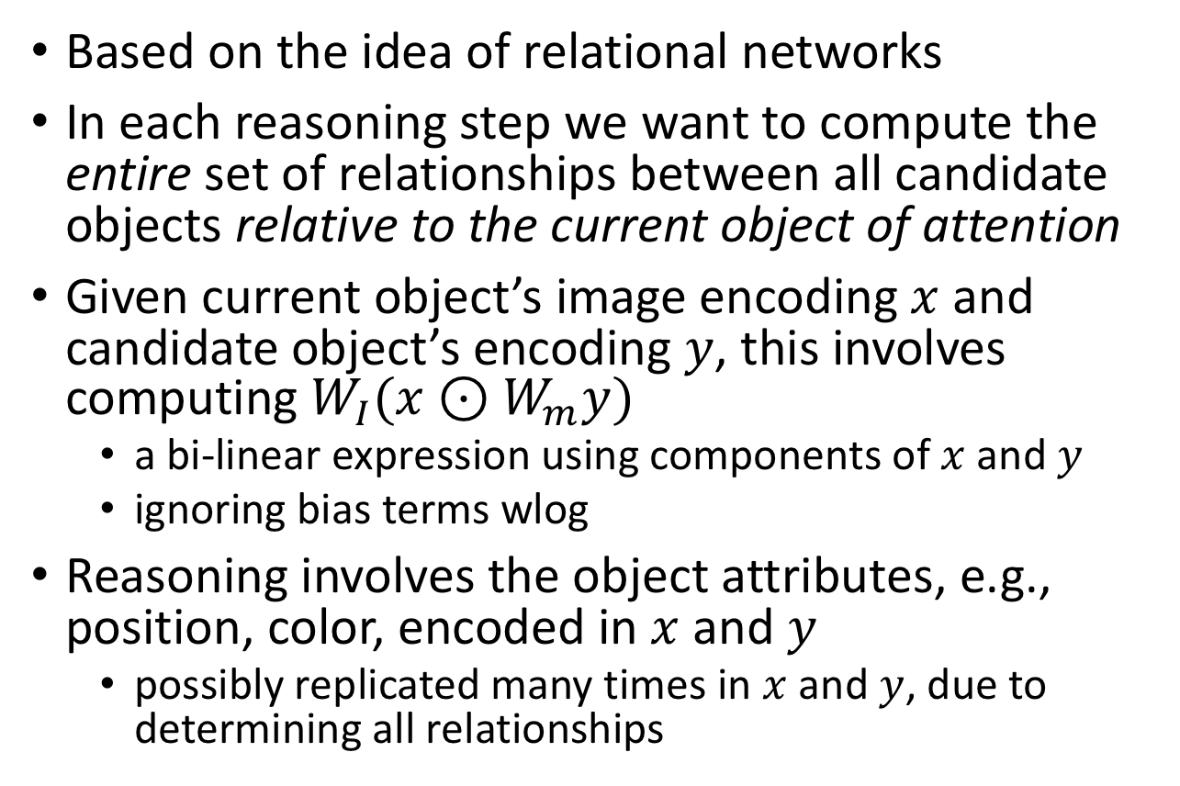
Our heuristic explanation
Based on the idea of relational networks
In each reasoning step we want to compute the entire set of relationships between all candidate objects relative to the current object of attention
Given current object’s image encoding $x$ and candidate object’s encoding $y$, this involves computing $W_{I}(x⊙W_{m}y)$
a bi-linear expression using components of $x$ and $y$
ignoring bias terms wlog
Reasoning involves the object attributes, e.g., position, color, encoded in $x$ and $y$
possibly replicated many times in $x$ and $y$, due to determining all relationships
1
2
3
4
12

